Slide 1
OBJECT DETECTOR
GROUP NO:- 1
CHIRAG GOYAL (16010201)
SURAJ DESAI (16010202)
MAHENDRA KUMAR (16010225)

Slide 2
INTRODUCTION :-
WHAT IS OBJECT DETECTOR???
A object detector is a sensor, able to detect the presence of objects nearby , without any physical contact.
If the object is detected, the detector is automatically turned on when the object is in the front of the detector.
A object detector often emits an electromagnetic field or group of electromagnetic radiation (infrared signal) for instance, and looks for changes in the field or return signal.

Slide 3
DESCRIPTION:-
Required components:-
9 VOLT BATTERY
LM358 OP-AMP
BATTERY CAP
BUZZER
RED LED
PCB BOARD (ZERO SIZE)
RESISTORS:-
100 OHM
10K OHM
220 OHM
10K VARIABLE RESISTOR
IR RX TX (TRANSMITTER, RECEIVER):-
TRANSMITTER (WHITE LED)
RECEIVER(BLACK LED)

Slide 4
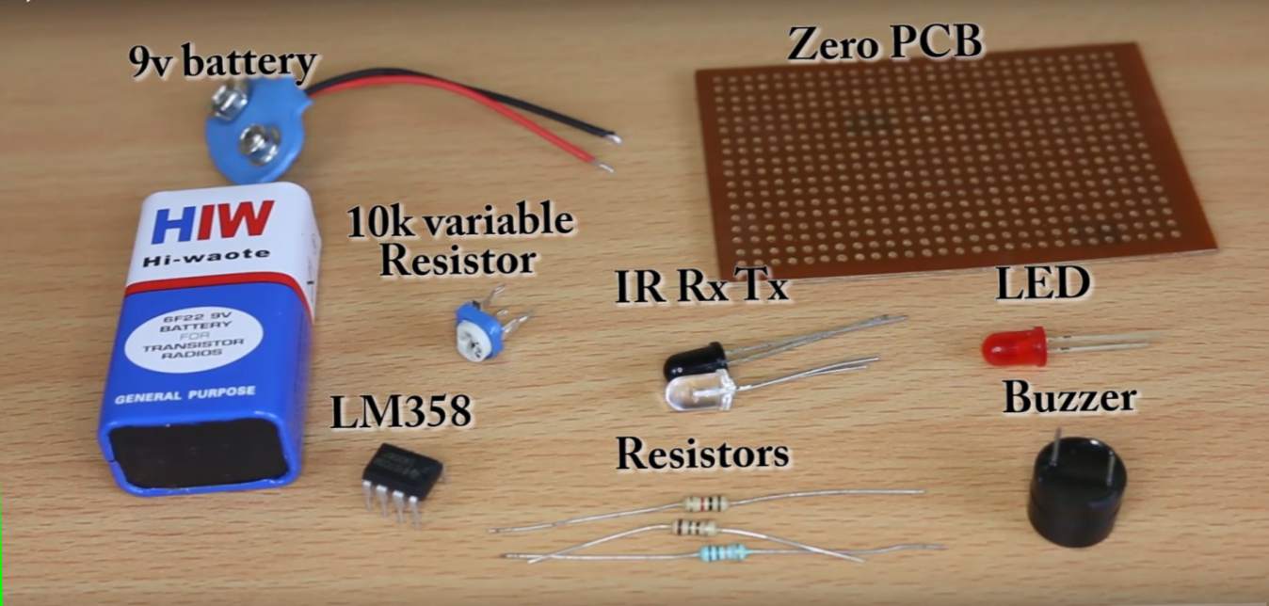

Slide 5
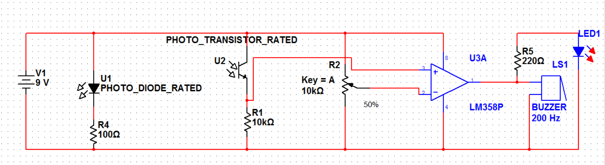
CIRCUIT DIAGRAM:-
WORKING PRINCIPAL :-
The main concept is simple, the IR led keeps transmitting infrared rays up to some range (there is a potentiometer also in the circuit with the help of which you can change the range).

Slide 6
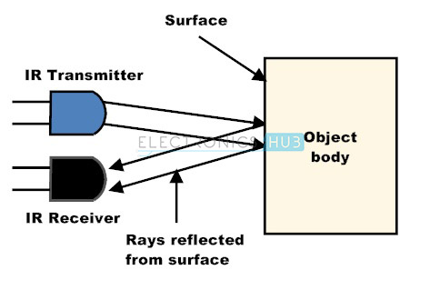
WORKING OF DEVICE:-
When we connect battery to the circuit the IR transmitter starts emitting infrared rays.
As soon as some object comes in the (IR) infrared range, the IR waves hits the object and comes back at some angle,
After that IR receiver detects that IR rays got reflected
from the object and hence works as object detector.

Slide 7
When the light emitted by the IR LED is incident on the photodiode after hitting an object, the resistance of the photodiode falls down from a huge value.
One of the input of the op – amp is at threshold value set by the potentiometer. The other input to the op-amp is from the photodiode’s series resistor. When the incident radiation is more on the photodiode, the voltage drop across the series resistor will be high .
In the IC, both the threshold voltage and the voltage across the series resistor are compared by
op -amp LM358 .

Slide 8
If the voltage across the resistor series to photodiode is greater than that of the threshold voltage, the output of the ic op – amp is high.
as the output of the IC is connected to an led, LED lightens up and buzzer starts producing sound .the threshold voltage can be adjusted by adjusting the potentiometer

Slide 9
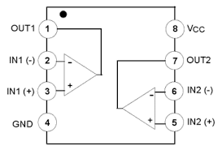
DETAILS OF COMPONENTS :-
OP-AMP LM358:-
The LM358 IC is a great, low power, high gain and easy to use dual channel op-amp IC. This IC is designed for specially to operate from a single power supply over a wide range of voltages. It can handle 3-32V DC supply & source up to 20mA per channel.
Figure:- INTERNAL DIAGRAM OF LM358

Slide 10
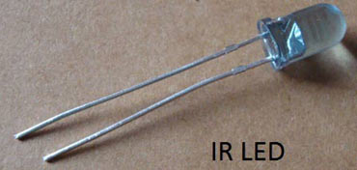
Pin Configuration of LM358 IC:-
The pin diagram of lm358 ic comprises of 8 pins, where
pin-1 and pin-7 are o/p of the comparator .
pin-2 and pin-6 are inverting .
pin-3 and pin-5 are non inverting .
pin-4 is gnd terminal .
pin-8 is vcc+
IR TRANSMITTER:-
The ir transmitter consists of the led that emits the ir (infra red) radiation. this is received by the photo diode, which acts as ir receiver at the receiving end. since the ir radiation is invisible to human eye it is perfect for using in wireless communication.

Slide 11
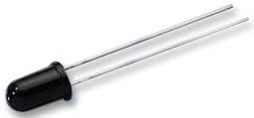
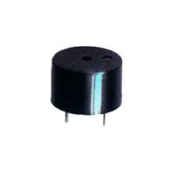
IR RECEVIER:-
The receiver contains either a photodiode
or a phototransistor. this component passes more or less
current depending on the amount of IR light falling on it.
BUZZER:-
buzzer is an electronic device commonly used to produce sound. It produces sound when voltage is applied .

Slide 12
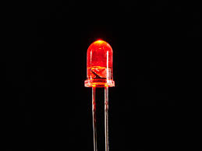
LED:-
a light-emitting diode (led) is a two-lead semiconductor light source. it is a p–n junction diode, which emits light when activated. when a suitable voltage is applied to the leads, electrons are able to recombine with electron holes within the device, releasing energy in the form of photons and LED glows.

Slide 13
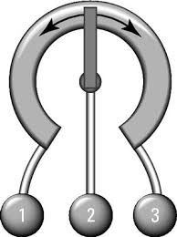
10k variable resistor:-
10k variable is used to set the range of
the sensor.
By changing the resistor value ,we can change the current and subsequently range also.

Slide 14
APPLICATION:-
object detector is used in various devices:-
It can be used as:
Advanced Wireless Automatic door bell .
Advanced Wireless Bank Security System
Motion detector .

Slide 15
Advantages:-
good stability.
high speed.
low cost.
detect both metallic and non targets.
low power consume.
Security purpose.
Save electricity .

Slide 16
Conclusion:-
The global market for these sensors is expected to grow at a steady rate. Major industries using object detector sensors are machine tools, woodworking machines, packaging machines and other types of machinery.
further applications of object detector sensors are automatic door units elevator doors or doors inside railway coaches.
So here we can conclude that an object detector sensor has great scope in future.

Slide 17
REFERENCE:-
WWW.ELECTRONICHUB.COM
WIKIPEDIA

Slide 18
THANK YOU

